Slide 1
WEBSITE FLOW
1. Header Bar
2. Banner+ Search Bar
3. Benefits
4. How BFH works
5. BFH Savings calculator
6. Featured Properties
7. Mortgage Assist
8. Help Desk/ Tools section
9. Upload your requirements… get contacted by owner
10. Blog Feed
11. Footer

Slide 2
1-2-3 HEADER, BANNER AND SEARCH BAR
Banner design will change. I’ll provide you in a couple of days.
Search Bar : The fields needed are… City, Location, Property Type, Beds, Budget
c. If these are too many to be fitted in this space, City can be moved to the header bar.
Budget currency is Dirham (AED) and not dollar. In fact throughout the website the currency is AED.
Links for Hamburger Menu
Mortgage Assist
Useful Links
Useful Forms
FAQs
Ask BFH

Slide 3
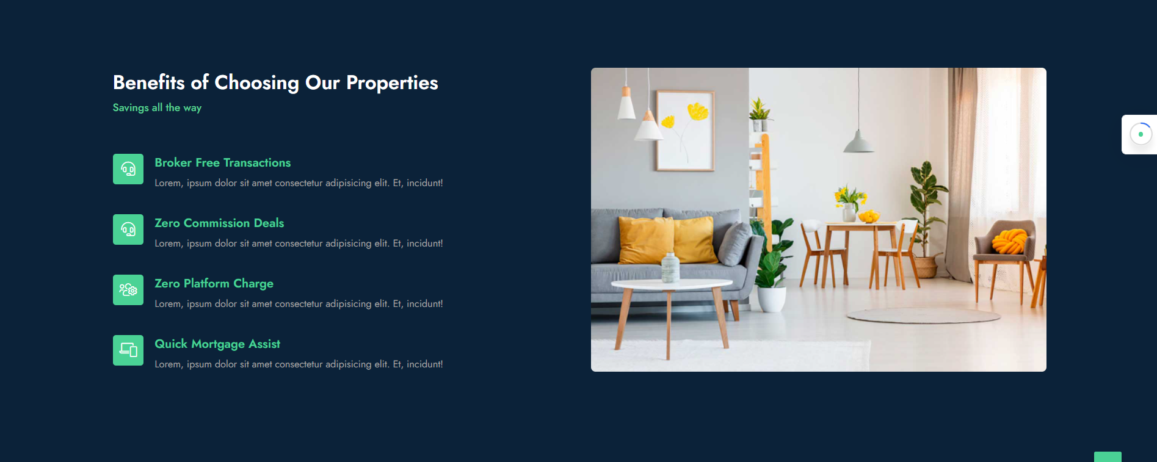
3. BENEFITS
Title to be changed to : Savings all the way
Subtitle : Enjoy a host of benefits on choosing properties through Broker Free Homes
Icons to be updated
Increase font size of benefits tiles to 18px
Running matter of all 4 benefits will be provided soon.

Slide 4
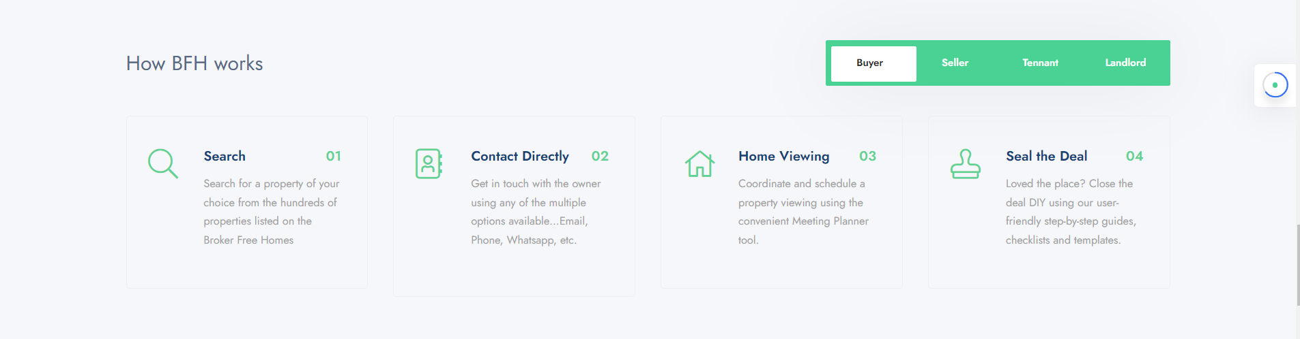
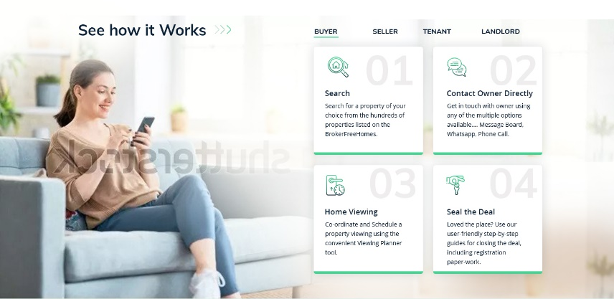
4. How BFH Works
Look of this section needs to be improved. Please refer the design on the left… Let us add an image in background and make the boxes a set of 2 x 2
Title text is “How to use Broker Free Homes”
Subtitle is “and save on commission”
Sharing image resources separately

Slide 5
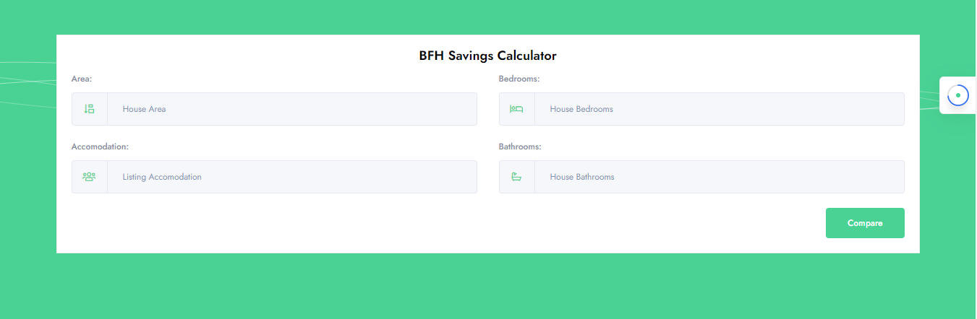
5. BFH Savings Calculator
Title “Savings Calculator”
Text/Sub-title: “Find out how much you’ll save if you transact using Broker Free Homes”
Fields
You are… [drop down with 4 roles… Buyer, Seller, Tenant, Landlord
Property Value / Rental Value (AED) [input field]
Commission % [will display 2% if role is Buyer or Seller. Will display 5% is role if Tenant or Landlord
On ‘Calculate’…. It displays ‘Hurray! You’ll save AED XXXX’
This section will have to be redesigned accordingly.

Slide 6
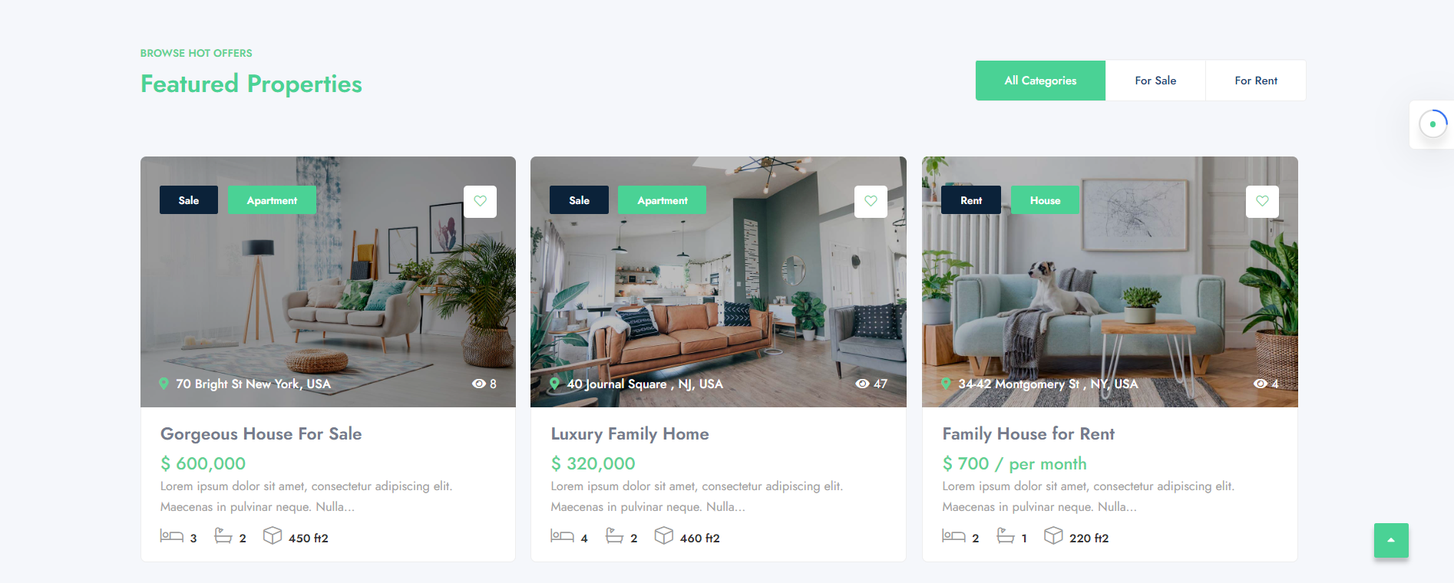
6A. Featured Property
Sub-Title “BROWSE PROPERTIES”
Title: Apartments for Sale, below AED 1 Mn
Query : Will the text like ‘Gorgeous House for Sale’ be input by the seller?
Point to be noted: The Address displayed with maps link will not have specific house number, but the general locality or Building name.

Slide 7
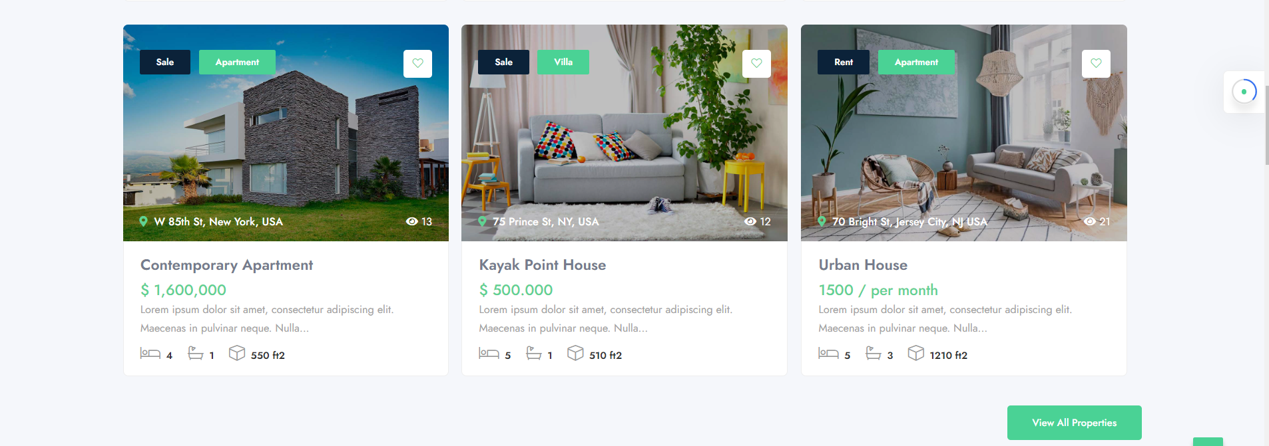
6B. Featured Property
Sub-Title “BROWSE PROPERTIES”
Title: Villas for Sale, below AED 2 Mn

Slide 8
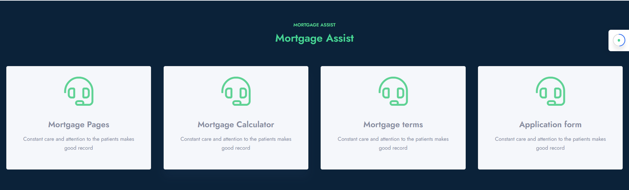
7. Mortgage Assist
This Section will have to be redesigned completely. Instead for 4 parts, there will be 3.
First one ‘Mortgage Calculator’ will be open for use on the home page.
Second One ‘Mortgage Compare’ will have a title and short writeup. On clicking it will open to a page.
Third one ‘Apply for Mortgage’ will have a title and a one liner writeup. . On clicking it will open to a form.

Slide 9
8. Useful Information
New section added with following heads
Useful Links
DIY Tutorials
Templates & Forms
FAQs
All will lead to a page

Slide 10
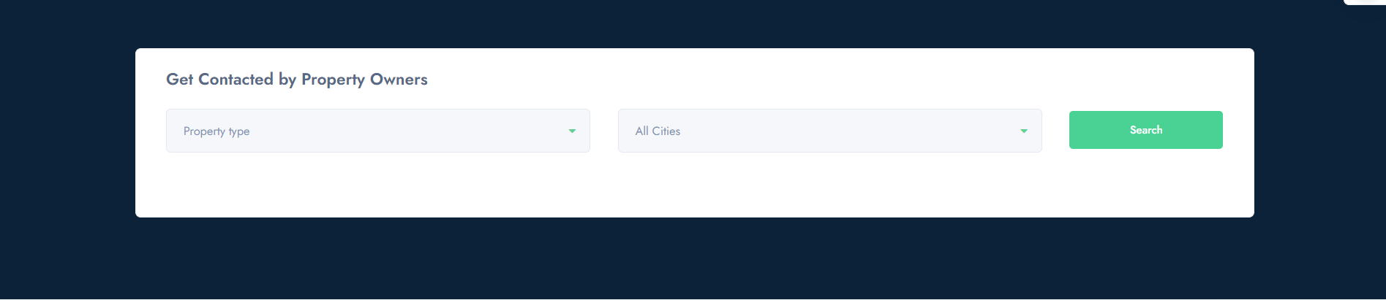
9. Upload your Requirements
TITLE: Get contacted by Property-owner
Sub-title: Tell us what you’re looking for, and get contacted directly by property owners.
Drop Down field: Purpose [buy/rent]
Drop down field: Property-type
Button: Get Started

Slide 11
Section “Looking for Buyers/Tenants for your property?? has been dropped
Blog and footer sections are fine.

Slide 12
THE END

